Slide 1

Parsl - Parallel Scripting Library for Python: Benchmarking, Analysis, Expedition & Improvement
Presented by:
Ismail Elomari Alaoui
Reda Chaguer
Project supervisors:
Dr. Ioan Raicu
TA: Alexandru Orhean
Notes:
Ismail

Slide 2
Plan
Introduction
Related work
Proposed solution
Evaluation
Conclusions
Notes:
Ismail: Start Intorduction = discuss project’s background, motivation and we state the major problem, Section 2 is Related work=where we present past research related to our project, Then we will present our proposed solution and evaluation in sections 3 and 4, Finally, we’ll discuss some potential problems and bottlenecks suggest some ideas and propose solutions in the conclusions section.

Slide 3
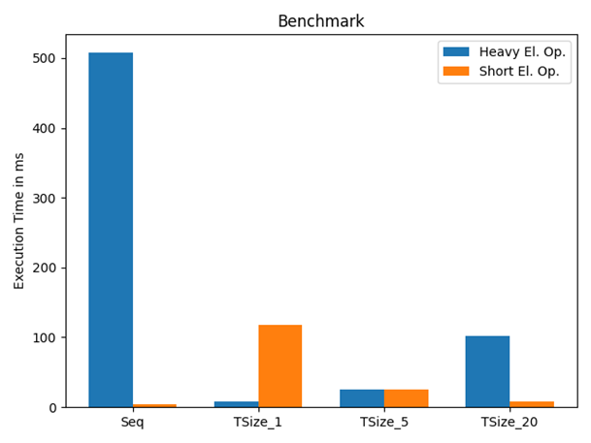
Introduction
Background:
Parsl is a parallel scripting library for Python.
Excellent in heavy-computational parallelism.
Weak in fine-grained parallelism
Problem Statement:
Motivation:
Previous experience with parallel computing.
Multiple multi-core programming projects conducted in C
Abelian Sand Model
Blurring Algorithm
…
Take up a new challenge in discovering, proposing solutions and contributing in Parsl.
Notes:
Reda

Slide 4
Related Work
Parsl’s Github: https://github.com/Parsl/parsl
Parsl’s website:
http://parsl-project.org/
Numerous benchmarks focused on heavy-computational parallelism
Served us as tutorials to understand Parsl’s functionality and performance
Notes:
Ismail: When we first started working on this project, Parsl’s Github depository, official documentation websites and reseacrh papers were vital to understand What is parsl, how to use it and how it works …..

Slide 5
Proposed Solution
Conception and implementation of numerous algorithms and workloads with an extensive variety of parameters
Profiling numerous programs using cprofile and Yappi
Profile visualization using Snakeviz
Benchmarking Parsl’s performance
Trying out different configurations
Comparing Parsl with other sequential as well as parallel computing tools
Creation of clear and concise graphs targeting precise areas in Parsl’s code
Notes:
Ismail

Slide 6
Evaluation
Fibonacci
Iterative Sequential
Recursive Sequential
Recursive Parsl join app using ThreadingPool
Recursive Parsl join app using HTEX
Square array
Parallel version using threading
Parallel version using multi-processing
Variety of parameters (tile size, array sizes, task duration, …)
Executor | Number of Nodes | Task duration for good performance
ThreadPoolExecutor | 1 (Only local) | Any
HighThroughputExecutor | <=2000 | Task duration(s)/#nodes >= 0.01 longer tasks needed at higher scale
Notes:
Reda

Slide 7
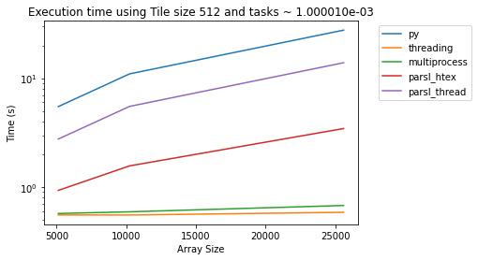
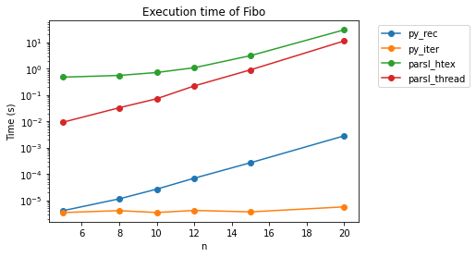
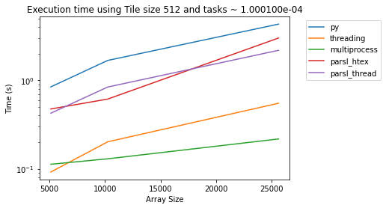
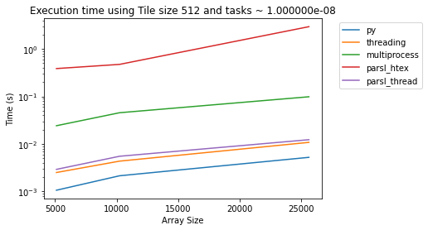
Evaluation On a 16 cores Machine
Demo 1: Visualization and Graph Creation
Notes:
Reda

Slide 8
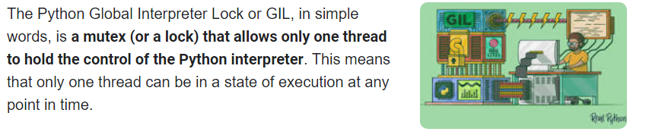
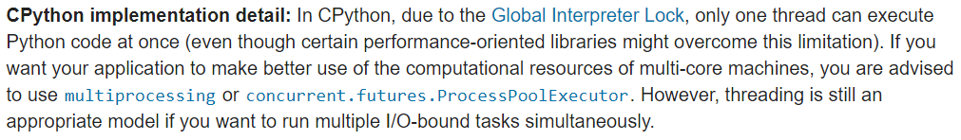
Conclusions: GIL
Source: https://realpython.com/python-gil/
Source: https://docs.python.org/3/library/threading.html
Notes:
Ismail

Slide 9
Conclusions: PyPy
Implementation of PyPy app
Great addition not only in fine-grained parallelism but also in heavy-computational parallel computing
Demo 2: PyPy, Speed in comparison to cpython
Notes:
Reda

Slide 10
Conclusions: Lack of real-time monitoring options
Parsl creates logs of execution
Logs and profiles can not give all necessary information in order to discover and solve all Parsl’s bottlenecks.
A proper real-time monitoring tool would be beneficial
Demo 3: EasyPAP, Square and Abelien Sand Model
Notes:
Ismail

Slide 11

Final conclusion
We value our project successful
Multiple benchmarks conceived and implemented
Numerous solutions and suggestions proposed
Future work could be pursuing any one of the 3 conclusions we presented.
In this project, we learned a lot about parallel computing in Python
Notes:
Ismail

Slide 12
Thank you for your attention
Notes:
Ismail

